Slide 1

HTML Basics
Web Development

Slide 2
HyperText Markup Language(HTML)
Describes the content and structure of information on a web page
It is not a programming language, it is a markup language
A markup language is a set of markup tags :
example : <title>…</title> <nav>…</nav> <p>…</p>
Text contents are surrounded with opening and closing tags
example: <p>This is a paragraph</p>
Notes:
HTML stands for Hyper Text Markup Language
It is used to describe content and structure of a Web page
It is not a programming language, it is a markup language – meaning that it is a language understood by the browser, and to tell the browser how to display the content of the web page.
A markup language has a set of markup tags: these tags usually comes in pairs. Like title, nav, paragraph <p> and </p>
The contents are surrounded within the pair of tags, for example, This is a paragraph is the content, and it is surrounded by the paragraph tag, represent by p

Slide 3
Basic HTML document(Web Page) structure
document
type
<!DOCTYPE html>
<html lang="en">
<head>
<meta charset="utf-8"/>
<title>This is my first web page</title>
</head>
<body> <p>My web content goes here.</p>
</body>
</html>
the root element of all html document
specifies character encoding of the html document
utf stands for Unicode Transformation Format. The '8' means it uses 8-bit blocks to represent a character.
http://www.w3schools.com/html/html_charset.asp
Notes:
This is the basic HTML document structure.
All HTML documents must start with a document type declaration: <!DOCTYPE html>. The <!DOCTYPE> declaration represents the document type, and helps browsers to display web pages correctly.
The HTML document itself begins with <html> and ends with </html>.
The visible part of the HTML document is between <body> and </body>.
The <head> element contains meta information about the document
The <title> element specifies a title for the document

Slide 4
Web Page Document Structure
Document Type Declaration
html
head
body
article/section
heading
paragraph
title
script (optional)
style (optional)
List
table
form
Notes:
This is the web page document structure.
As mentioned earlier, a html document will have 2 main section head and body.
And within the body, it can contain the visible page content, so you can find elements such as heading, paragraph, list, tables, form and so on..

Slide 5
HTML Element
A HTML document consists of HTML Elements
element = opening tag + content + closing tag
Example 1 : (lower case, properly closed)
<p>This is a paragraph </p>
Example: (properly nested)
<div>
<p>This is a paragraph </p>
</div>
Example: (empty element)
This is a line break<br>
Notes:
A html document consists of html elements.
The HTML element is everything from the start (or opening) tag to the end (or closing) tag.
For example, we have a paragraph element here:
<p>This is a paragraph </p>
(opening tag) (content) (closing tag)
Some elements do not have content, e.g. the line break element <br>
It does not have any content, or end tag. It is called an empty element.

Slide 6
HTML Elements
Empty elements (with self-closing tag, no content)
Tag that does not wrap around anything
Example:
<img src="pic1.jpg"> or <img src="pic1.jpg" />
Notes:
Another example of an empty element is the image element.
Remember, an empty element do not have content to wrap around, and there is no closing tag.

Slide 7
HTML Attribute
Example:
<img src=“mickey.jpg”>
Attribute name
Attribute value
Attribute provides more details information pertaining to the element it belongs to.
Notes:
Next I want to introduce attributes.
An element can have attributes. Attributes are to provide more information about the element.
For example, in this image element, it comes with an attribute, call source, and a value for the attribute.
So it means, this image element will display a image from this file.

Slide 8
HTML Document
Example:
Indicate the theme/ main topic of this page, not only that it is bold ..
<!DOCTYPE HTML>
<html>
<head>
<title>My Page</title>
</head>
<body>
<h1>Welcome to my page</h1>
<p>I like cars and lorries and have a big Jeep!</p>
<h2>Where I live</h2>
<p>I live in a small hut on a mountain!</p>
</body>
</html>
speech browser might use a different volume or a slower voice
Search engines can use the headings to more effectively index
Software tools can use the headings to create a table of contents
Go to ATOM
Notes:
Let’s look at some html elements.
In this document, we have the heading elements, the paragraph elements.
Take note that a heading elements (which can be defined as h1 to h6),
Headings Are Important
Search engines use the headings to index the structure and content of your web pages.
<h1> headings should be used for main headings, followed by <h2> headings, then the less important <h3>, and so on.
Each HTML heading has a default size. However, you can specify the size for any heading with the style attribute.
For paragraph tag, Browsers automatically add some white space (a margin) before and after a paragraph.

Slide 9
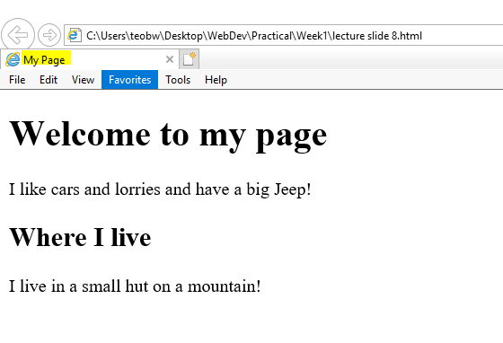

Slide 10
Categories of Elements
Root element
<html>
Elements which carry information of the document ( not displayed as part of the content of the web page)
For example
<head>, <title>, <meta>,<style>,<link>
Notes:
There are Elements which carry information of the document, they are not displayed as part of the content of the web page.
For example, the HTML tag, the head, title tags and so on

Slide 11
Categories of Elements
For Sectioning and Headings
Examples:
<body>,<article>,<section>,<nav>,<aside>,<header>,<footer>,<address>
<h1>,<h2>,<h3>,<h4>,<h5>,<h6>
For Grouping content
Examples:
<div>, <p>, <ul>,<ol>,<li>,<figure>,<figcaption>,<hr>
Notes:
There are many categories of html elements, some are for sectioning your documents, some may be used for grouping contents.
For example, the
The <section> tag defines sections in a document, such as chapters, headers, footers,
The <div> tag defines a division or a section in an HTML document.
The <div> element is often used as a container for other HTML elements to style them with CSS stylesheet.
//The hr element represents a paragraph-level thematic break, e.g. a scene change in a story, or a transition to another topic within a section of a reference book.
The <hr> element is most often displayed as a horizontal rule (i.e. a horizontal line) that is used to separate content (or define a change) in an HTML page.
Grouping content will not affect the document outline.

Slide 12
Categories of Elements
Text level
Examples:
<a>,<em>,<strong>,<span>,<br>,<cite>
Each has it’s own purpose
With embedded content
Examples:
<img>,<audio>,<video>,<iframe>
Links
Example:
<a>
Notes:
For formatting text, you may use these tags:
Just like you can format text in word using bold, italic, underline, you can use html tags to style your text in the content.
<a> tag will under the text to denote it is a hyperlink
Em and strong will change the font of the text to italic and bold.
You may embed other types of content besides text in your html document, you can use
<img> - to embed an image in your document
<audio> - to embed an audio file
<video> - to embed a video file.
You may define hyperlink in your text using the <a> tag.

Slide 13
Categories of Elements
Tabular
Example
<table>, <tbody>,<thead>,<tfoot>,<tr>,<td>,<th>, <caption>
To tabulate data
Form
Example
<form>,<label>,<input>,<button>,<select>,<textarea>,<fieldset>
To create form for user input and interaction
Notes:
You can also define tables in your html document, as you did in a MS WORD document. There are different tags to support the table features, you will learn how to use them in the practical.
You can design forms for users input, as you saw in a typical customer sign up form.
Again we will learn how to design a form in our practical

Slide 14
Special Characters
Character | Description | Entity Name | Entity Number
< | less than | &lt; | &#60;
> | greater than | &gt; | &#62;
& | ampersand | &amp; | &#38;
¢ | cent | &cent; | &#162;
" | quotation mark | &quot; | &#34;
' | apostrophe | &apos; | &#39;
© | copyright | &copy; | &#169;
 | non-breaking space | &nbsp; | &#160;
Notes:
Some characters are reserved in HTML.
If you use the less than (<) or greater than (>) signs in your text, the browser might mix them with tags.
Therefore, to display reserved characters in HTML, you need to code its entity name or number.
For example, To display a less than sign (<) we must write: &lt; or &#60;
& = Ampersand

Slide 15
White space
White space will be ignore by the web browser
To explicitly indicate the existence of a space
&nbsp;
To have a line break
<br>
To have a horizontal line
<hr>
Notes:
White spaces in your html document will be ignore by the web browser.
To explicitly introduce spaces, you have to code &nbsp; in your html document
To have an empty line, use the line break tag <br>
To draw a horizontal line, use the <hr> tag

Slide 16
Comments
To insert comments in a web document
<!- - Comments Here -->
to provide developers with a way to comment their code without it being rendered on the page
Notes:
You add comments using this tag.
The comments is used by developers to add comments to their coding, and they will not be shown when you renders the page in a browser

Slide 17
Organization of files
Folder is also named as directory
Root Folder
Folder1
Subfolder1
Subfolder2
Folder2
fileA
fileB
fileC
fileD
A path indicate the location of a directory or file
Notes:
A folder is also called a directory.
A file path describes the location of a file in a web site's folder structure.
File paths are used when linking to external files like:
Web pages
Images
Style sheets
JavaScripts

Slide 18
Working Directory
Root Folder
Folder1
Subfolder1
Subfolder2
Folder2
fileA
fileB
fileC
fileD
Current Folder/Directory that you are working on now
Notes:
The working directory refers to the current folder or directory that you are working on.

Slide 19
Absolute Path
Absolute Path of fileA is
C:/root/Folder2/fileA
Drive C:
root
Folder1
Subfolder1
Subfolder2
Folder2
fileA
fileB
fileC
fileD
Notes:
An absolute file path is the full URL to a file, starting from the root drive, c: or d: drive

Slide 20
Relative Path
Relative Path of fileC is
fileC
Drive C:
root
Folder1
Subfolder1
Subfolder2
Folder2
fileB
fileC
fileD
fileA
Working Directory
?
Working on fileB
Notes:
A relative file path points to a file relative to the current page.
In this example,
The working directory is subfolder1. Both file B and file C are located in subfolder1, i.e. same directory. Thus when working on fileB and you want to refer to file c, the relative path of file c is filec.

Slide 21
Relative Path
root
Folder1
Subfolder1
Subfolder2
Folder2
fileB
fileC
fileD
fileA
Drive C:
Working Directory
Relative Path of fileD is
../Subfolder2/fileD
Working on fileB
?
Notes:
However, if when you are working on fileB and you want to refer to fileD, which is in another subfolder called subfolder2, basing on the directory structure,
You need to traverse from working directory to its parent directory, then step down into the subfolder2.
To traverse up to its parent directory, use ..
To step down into subfolder2, use /subfolder2
Thus the relative path for fild d will be ../subfolder2/filed.

Slide 22
Relative Path
root
Folder1
Subfolder1
Subfolder2
Folder2
fileA
fileB
fileC
fileD
Drive C:
Working Directory
Relative Path of fileA is
../../Folder2/fileA
Working on fileB
Notes:
To reference file A, You need to traverse from working directory up 2 level to its parent directory, then step down into the folder2.
Thus the relative path for fild a will be ../../folder2/fileA.

Slide 23
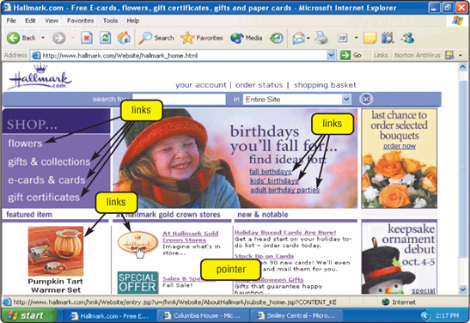
Hyperlink
Pointer changes to a small hand when you point to a link
A link can be text or an image
Text links are usually underlined and in a different color
Notes:
Hyperlinks are important in a html document. You can click on a hyperlink and jump to another page.
When you move your mouse over a link, it mouse pointer changes into a small hand.
A hyperlink does not have to be text. It can be an image which when you click on it, it brings you to a new page.
Hyperlinks are usually displayed as underlined and in a different color.

Slide 24
Hyperlink tag
Hyperlinks use the following HTML tag
HTML Tag | Purpose
<a href=… target=…>…</a> | Defines a hyperlink
Target Attributes
target="_blank" | target="_blank" Loads the new document in a new blank window
target="_self" | target="_self" Loads the new document in the same window as the anchor (default)
target="_parent" | target="_parent" Loads the new document in the parent frame (when using frames)
target="_top" | target="_top" Loads the new document in the entire browser window (nice way to break out of frames)
<a>…</a> | A placeholder for a hyperlink
Notes:
Hyperlinks are defined with the <a> tag:
The href attribute specifies the destination address of the link.
The target attribute specifies where to open the linked document.
_blank - will load the new or linked document in a new window or tab
_self -will open the linked document in the same window/tab as it was clicked (this is the default behaviour )

Slide 25
Adding a hyperlink
<a href=“ ”>UserSeeThisText</a>
Indicate the destination of the link,
Could be external link e.g.
http://www.google.com.sg
Could be within the website
Could be within the same page
Could be an email address with a mailto: prefix
User click at this text .
it could also be an image
Hyperlink can point to any resource on the Web: a HTML page, an image, a sound file, a movie, etc.
Notes:
The link text is the visible part presented to the user, e.g. User See This Text is visible.
Clicking on this link text will send you to the destination of the link, which can be an external website, or another page within the website, or other resources such as email system, an image, a audio or video.
It is common to use images as links. Replace the link text with the img element

Slide 26
Adding a hyperlink
With the target attribute, you can define where the linked document will be opened:
New browser window
Same browser window
Example, to open www.nyp.edu.sg in a new browser window when the link is clicked:
<a href="https://www.nyp.edu.sg" target = "_blank">Visit NYP! </a>
show
Notes:
This example shows that when clicking on the link text Visit NYP, it will open the nyp website www.nyp.edu.sg, and in a new browser tab.

Slide 27
Hyperlink within the same web page
Step 2: Create the link to the bookmark
<a href="#tips">Useful Exam Tips! </a>
Step 1: Give an identity to the destination:
<p id=“tips”>The paragraph that contains all the tips</p>
Notes:
HTML bookmarks are used to allow readers to jump to specific parts of a Web page.
Bookmarks can be useful if a webpage is very long.
first create the bookmark at the p tag – the bookmark is named tips.
When the a link is clicked, the browser will display the content at the bookmark.

Slide 28
Hyperlink to another web page
Web page within the same web site
<a href=“hobbies/football.html”>about football</a>
Web page at the other web sites
<a href=“http://www.abc.com/football.html”>about football</a>
Notes:
These hyperlinks brings you to another web page.
Take note that relative path is used in the first example.

Slide 29
Hyperlink to a specific location of another web page
<a href=“hobbies/football.html#shooting”>about football</a>
Current viewing page
Football.html
<a href=“hobbies/football.html#shooting”>about football</a>
<p id=“shooting”>
</p>
show
Notes:
In this example, a bookmark called shooting is created.
When the link is clicked, the page will jump to the paragraph bookmarked as shooting

Slide 30
An Email Link
Hyperlinks may also be used to send email
When an email hyperlink is clicked, the email program will be launched.
Example:
<a href="mailto:mrbean@yahoo.com">
Send email to Mr Bean </a>
Notes:
When an email hyperlink is clicked, the email application will be launched.

Slide 31
An Email Link
A more complicated email hyperlink can be found at:
http://www.w3schools.com/html/tryit.asp?filename=tryhtml_mailto2

Slide 32
Navigation Links
Use <nav> to group main links in the page
This also helps to enhance the efficiency of user agents such as screen reader or search engine
<nav>
<a href="#bukit_timah">Bukit Timah Nature Reserve</a>
<a href="#chinese_garden">Chinese Garden</a>
<a href="#japanese_garden">Japanese Garden</a>
<a href="#fort_canning">Fort Canning</a>
</nav>
Notes:
Navigation tag is used to group all the hyperlinks in the page
Browsers, such as screen readers for disabled users, can use this element to determine whether to omit the initial rendering of this content.

Slide 33
Embed An Image
The purpose of adding image
To enhance illustration (help to explain)
Example : Figure such as pie chart
To enhance experience (aesthetic purpose)
Example
Logo
Icon (as a hyperlink or button)
Background image
To display picture content
Example
Photo Gallery
Notes:
Some of your website contents may be images, or you may use images to enhance your user’s experience or use image as illustration.

Slide 34
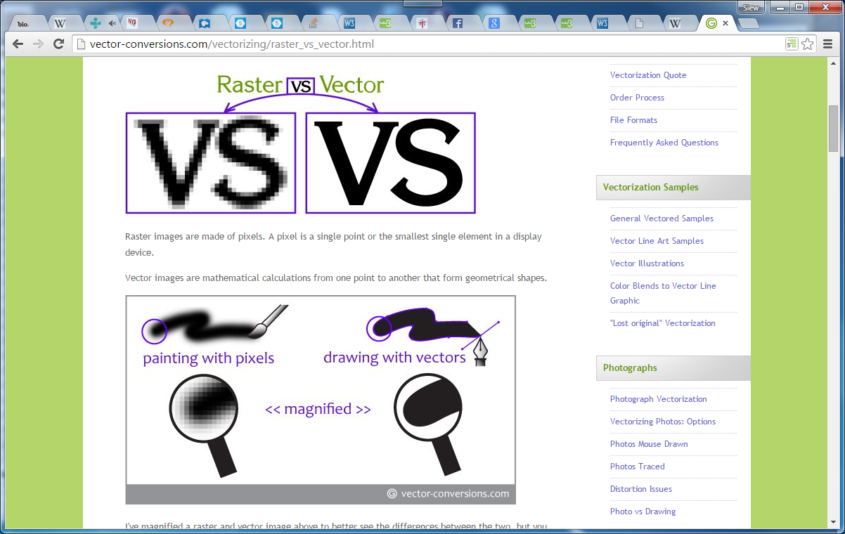
Embed An Image
Images can be in different format:
Raster formats:
Example: jpg, gif, bmp, png
Vector formats:
Example: svg
Picture from Vector-conversion.com
Notes:
Images can be in different format

Slide 35
Embed An Image
Choose the right format and size of image may
affect the experience of your website
Speed of loading
Clarity
Further reference
http://www.websiteoptimization.com/speed/tweak/format
https://developers.google.com/web/fundamentals/performance/optimizing-content-efficiency/image-optimization
Notes:
Choose the right format and size of image as it may affect the speed of loading of your website

Slide 36
Embed An Image
<img src=“ “ alt=“ “>
Where is the image file
Alternative text to replace the image, if
for example:
Image file not available, text will be displayed
Text will be read out if it is meant for people with visual disability
Notes:
To embed an image, use the img element.
You can specify an alternative text to be shown, if the image file is not available.
This alternative text will also be read if it is meant for user with visual disability

Slide 37
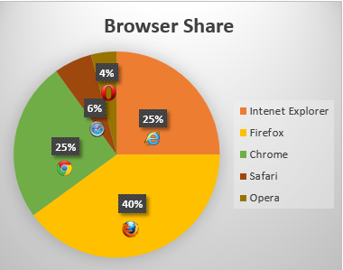
Embed An Image
<img src="piechart.gif" alt="Pie chart: Browser Share - Internet Explorer 25%, Firefox 40%, Chrome 25%, Safari 6% and Opera 4%.">
Informative value provided in alt attribute
Example extracted from www.w3.org
Notes:
Informative values can be provided in the alternative attribute value.

Slide 38
Embed An Image
<img src=“ ” alt=“ ”
width=“ ” height=“ ”>
Optional attributes if specified help the browser in determining the space to be reserved for the image
Size of image can also be specified using CSS property:
For Example: img { width:60px; height:60px}
All images will be of size 60px by 60px
showImageWithSize
Notes:
Use the width and height attribute to specify the image size
//Take away the width and height attributes, the screen flicker when loading..

Slide 39
Embed Image as a hyperlink
<a href=“ ”><img src=“ ” alt=“ ”></a>
Destination of the link
User click at the image to access the designated link/resources
Notes:
This is an example of using image as a hyperlink
When user click on the image, the browser will be jumped to the destination specified in href attribute

Slide 40
Lists
HTML Tag | Purpose
<ol>…</ol> | Defines an ordered list
<ul>…</ul> | Defines an unordered list
<li>…</li> | Defines a list item
<dl>…</dl> | Defines a description list
<dt>…</dt> | Defines a name (e.g. term, question)
<dd>…</dd> | Defines a value for the name (e.g. description, answer)
Notes:
http://www.w3.org/TR/html-markup/dl.html
There are different types of lists in html documents

Slide 41
Unordered List
to present information in point form
to contain a list of items, such as links, pictures, video
<p>Which type of the fruits do you like the best ?</p>
<ul>
<li>Apple</li>
<li>Orange</li>
<li>Banana</li>
</ul>
<ul>
<li><a href=“home.html”>Home</a></li>
<li><a href=“contact.html”>Contact Us</a></li>
<li><a href=“about.html”>About Us</a></li>
</ul>
<ul>
<li><img src=“images/pic1.jpg “ alt=“picture of mother”></li>
<li><img src=“images/pic2.jpg” alt=“picture of father”></li>
<li><img src=“images/pic3.jpg” alt=“picture of brother”></li>
</ul>
Example
Notes:
An unordered list is used to present information in point form
//it starts with the <ul> tag, and each list item starts with the <li> tag.
The list items will be marked with bullets (small black circles) by default
You can have other list item markers, such as circle, square, by setting the style attribute of the UL tag.
//The CSS list-style-type property is used to define the style of the list item marker

Slide 42
Ordered List
to display a number of items (count/order emphasised)
to describe steps to follow
<h2>What to bring?</h2>
<ol>
<li>Passport</li>
<li>IC</li>
<li>Money</li>
</ol>
<h2>Directions:</h2>
<ol>
<li>Preheat the broiler. Cover the broiling pan with …..</li>
<li>Place the steaks on the pan and broil the salmon for 5 minutes… <li>
<li>Serve immediately topped with the sauce of your choice.</li>
</ol>
Example
Notes:
An ordered list will order its items in some order.
//It starts with the <ol> tag, and each list item starts with the <li> tag.
The list items will be marked with numbers by default.
You can have other list item markers, such as letters or roman numbers , by setting the type attribute of the OL tag.

Slide 43
Ordered List
type - attribute to choose type of numbering
Value can be 1 or a or A or i or I
start – attribute to indicate starting number
Value can be an integer
Notes:
Use the start attribute to indicate a different starting number

Slide 44
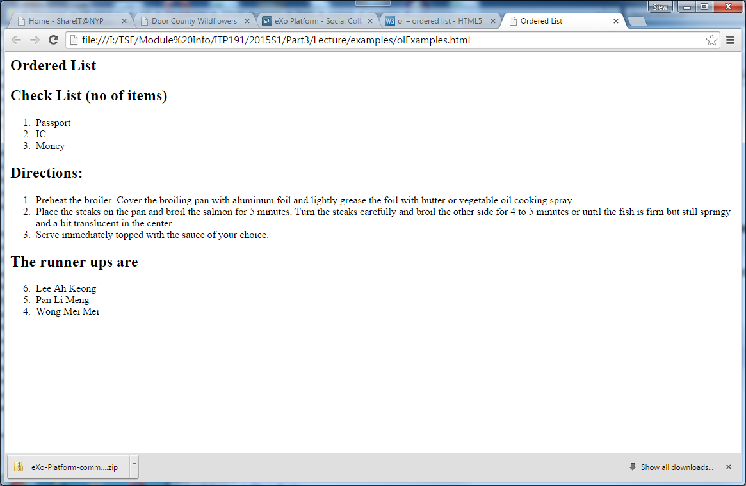
Ordered List
reversed
Value can be reversed or just the attribute without value
<ol type="1" start="6" reversed>
<li>Lee Ah Keong</li>
<li>Pan Li Meng</li>
<li>Wong Mei Mei</li>
</ol>
Example
Notes:
The list number can be reversed in reversed order too

Slide 45
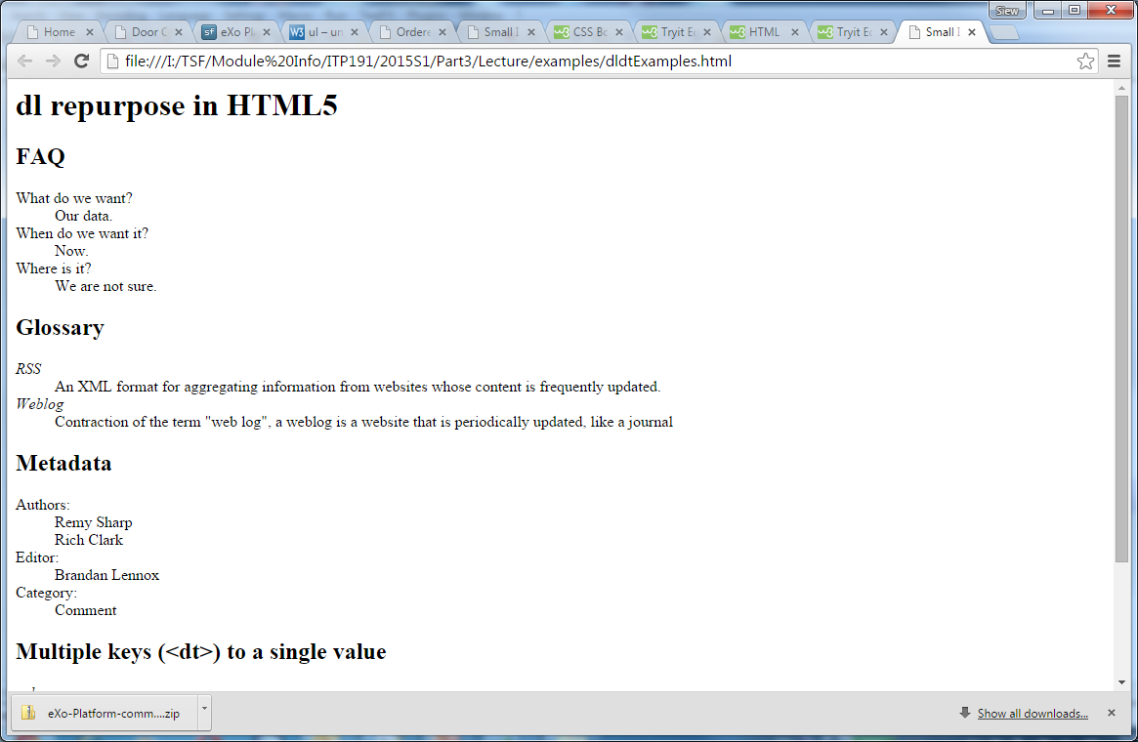
Description List
to define terms
to list questions and answers
to group a list of name and value pair
<h2>Metadata</h2>
<dl>
<dt>Authors:</dt>
<dd>Remy Sharp</dd>
<dd>Rich Clark</dd>
<dt>Editor:</dt>
<dd>Brandan Lennox</dd>
<dt>Category:</dt>
<dd>Comment</dd>
</dl>
<h2>Glossary</h2>
<dl>
<dt><dfn>RSS</dfn></dt>
<dd>An XML format for aggregating information from websites whose
content is frequently updated.</dd>
<dt><dfn>Weblog</dfn></dt>
<dd>Contraction of the term "web log", a weblog is a
website that is periodically updated, like a journal</dd>
</dl>
examples
Notes:
A description list is a list of terms, with a description of each term.
The <dl> tag defines the description list, the <dt> tag defines the term (name), and the <dd> tag describes each term

Slide 46
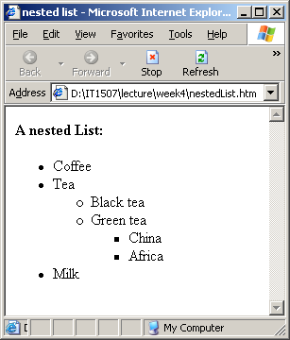
Nested List Example
<h2>A nested List:</h2>
<ul>
<li>Coffee</li>
<li>Tea
<ul>
<li>Black tea</li>
<li>Green tea
<ul>
<li>China</li>
<li>Africa</li>
</ul>
</li>
</ul>
</li>
<li>Milk</li>
</ul>
Notes:
List can be nested, that is, lists inside another lists

